Slide 1
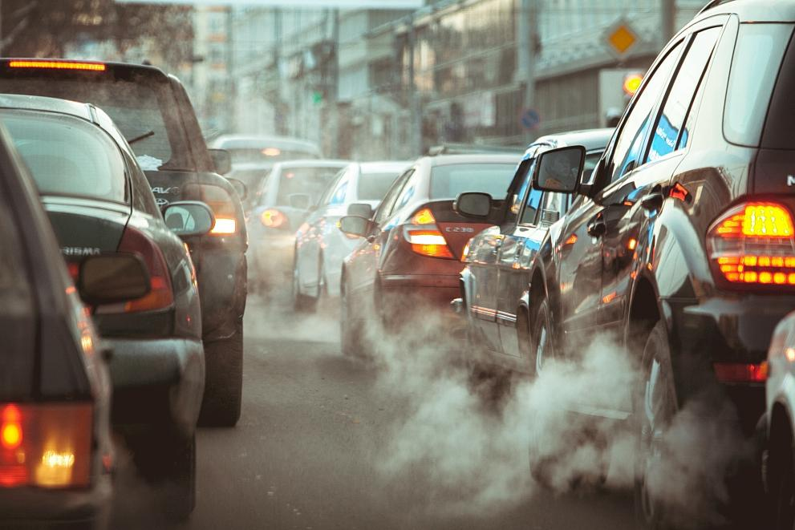
AI-Enabled Traffic and Pollution Prediction
By
Aaditya Jhamb
Notes:
Hello. I am Aadi, and I’m from King’s College School Wimbledon. I’m here today to tell you about our project where we developed cost-effective sensors and advanced AI models to monitor and forecast traffic and pollution levels. By integrating machine learning techniques with real-time data collection, our solution aims to empower communities to mitigate the environmental impacts of congestion, helping with urban sustainability.

Slide 2
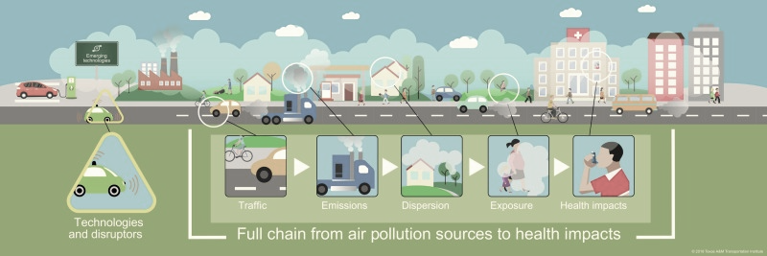
Why is traffic related pollution important to monitor for communities?
Asthma
Respiratory Illnesses
Lung Cancer
11% of childhood asthma caused by traffic are due to PM 2.5
Notes:
We all know that traffic is a major problem in London. In 2022, Fleet News estimated that 2.2 megatons of CO2 were attributed to traffic jams. This traffic-related pollution isn't just an inconvenience; it directly endangers public health. Shockingly, 11% of childhood asthma cases are caused by PM2.5, a pollutant released during traffic congestion; on a personal level, my grandfather suffers from COPD and is affected by the pollution in London. Hence, I embarked on this project to forecast traffic using air pollution data. My aim is to grasp traffic dynamics and its harmful effects, ultimately seeking ways to mitigate these impacts.

Slide 3
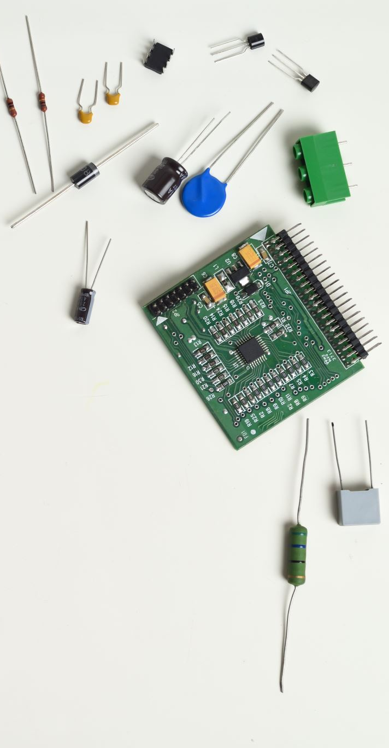
What is being done currently?
Notes:
Many studies utilize Machine Learning and past data to forecast traffic. Research also exists on AI-driven air quality prediction for smart cities. My research stands out for targeting both traffic congestion and pollution using AI.

Slide 4
Our Solution
Sensor to detect air pollution
Traffic Imagery to validate the number of cars
LSTM model for predicting future traffic
Notes:
My solution is a cost-effective and yet accurate mode of forecasting traffic using air pollution data.
Part 1: Sensor Development
I created a cost-effective sensor to measure GHGs.
Installed a camera sensor to record roadway traffic simultaneously.
Utilized an automated machine learning model to detect cars from the traffic data.
These three in tandem enabled me to understand the relationship between traffic conditions and air pollution levels.
I also wanted to see if it is possible to forecast future traffic levels given pollution data:
Investigated the correlation between pollution levels and traffic conditions.
Developed an LSTM deep learning model to forecast future traffic levels based on historical pollution data.
Demonstrated that air pollution data can be used as a proxy for forecasting traffic at specific times.
Moving forward, I am going to go into the details of the experiments I conducted for each of the three components of my project.

Slide 5
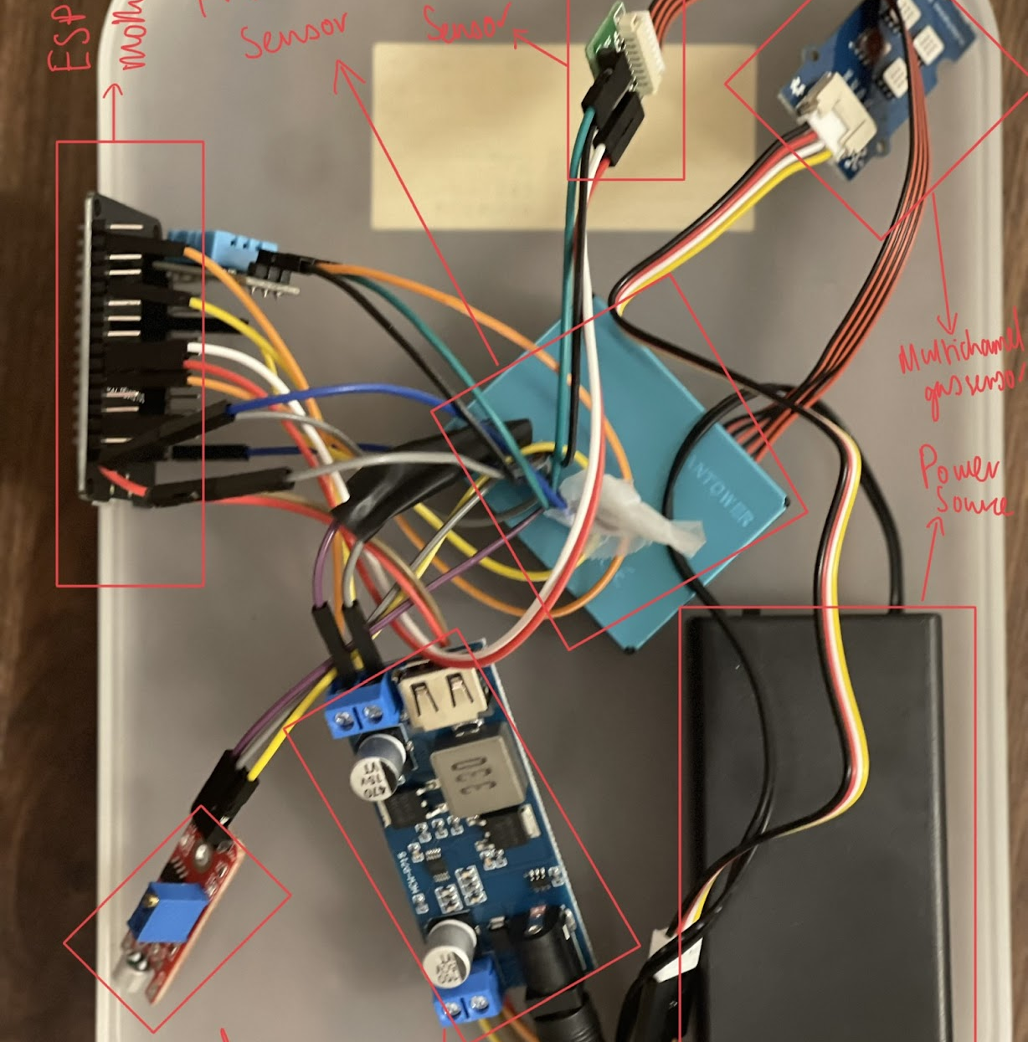
Experimental Procedure – Prototype Sensor
PM 2.5
Volatile Gases
Temperature- Humidity
CO2
NO2
Methane
Notes:
To gather local air pollution data, we constructed a sensor monitoring atmospheric conditions. It integrates temperature-humidity, PM2.5, CO2, volatile gases, NO2, and Methane sensors together on an ESP-32 board.
(Aadi): To streamline this process, we learned Adurino sensor operation.
Data from sensor was transmitted to our computer via a MQTT client, hosted on a web server. Micro Python code was used to allow data packet transmission.
We strategically placed our sensor on a busy road junction. At the same time, to obtain aerial images, we also placed a camera next to our sensor to record the vehicles. The timeframes of the camera corresponded to the air pollution data, which allowed us to assess the impact of traffic on greenhouse gas emissions.

Slide 6
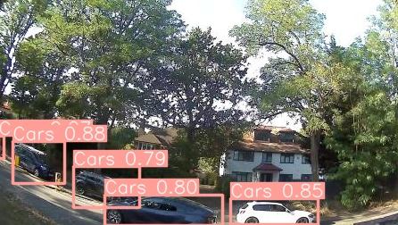
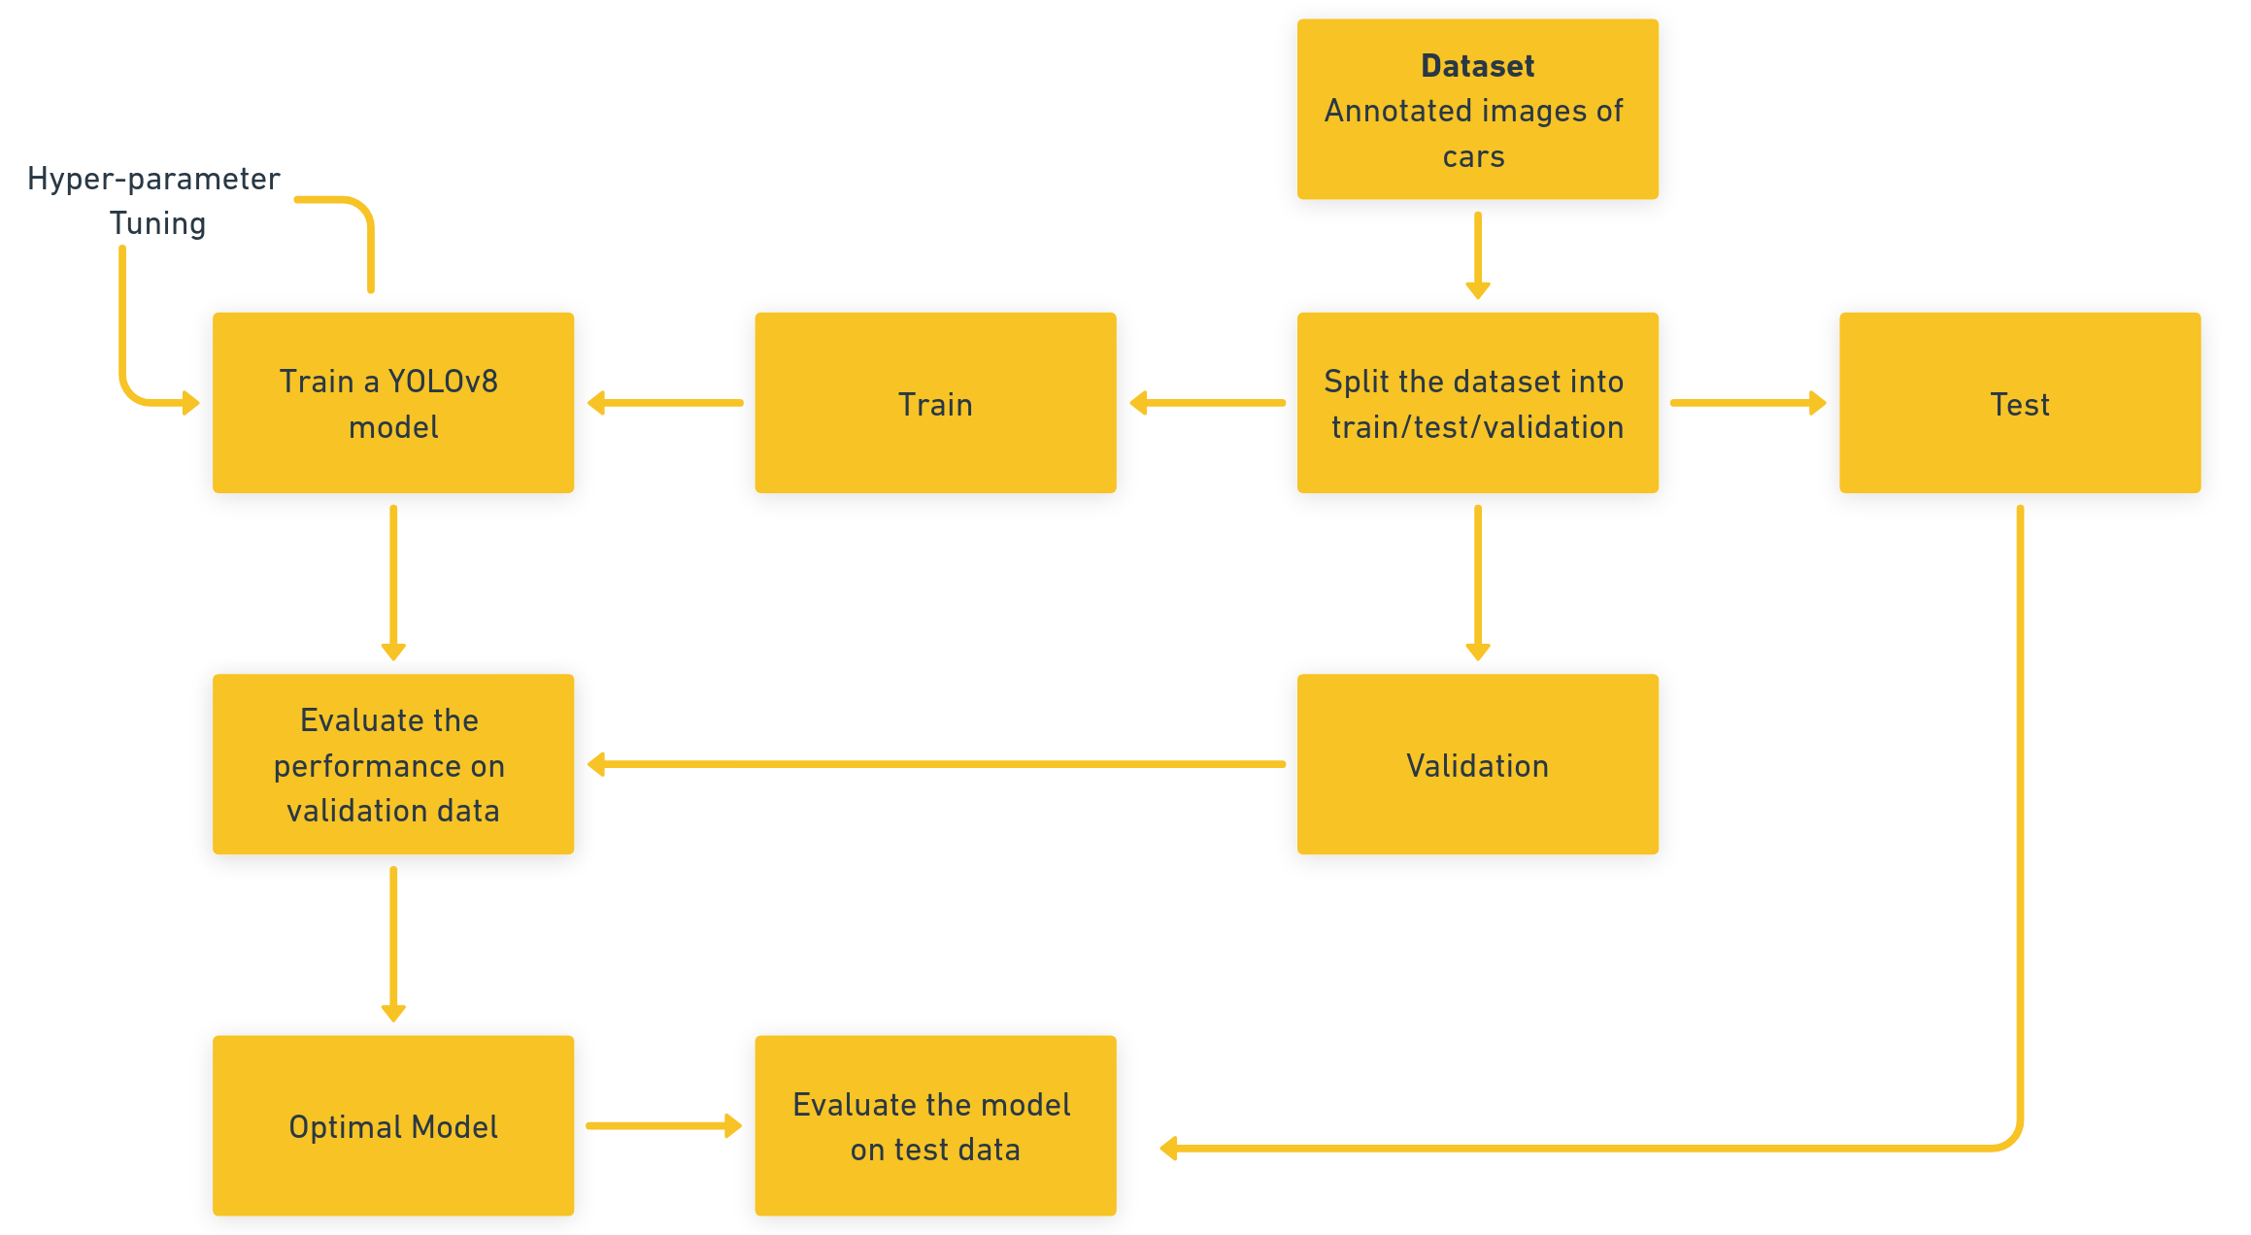
Experimental Procedure – Traffic Detection
Notes:
To begin with, to detect traffic in the local area, I used a camera to record the traffic for 3 days. I then annotated 263 images from the camera, labelling whether the vehicle was a car, a bus etc. We then split this data into training data, testing data, and validation data at (185 (70.3%)/52 (19.8%)/26 (9.9%)). The training data was used to train a YOLOv8 object detection model to identify and count the number of vehicles at a certain point in our area. I conducted hyper-parameter tuning on the YOLOv8 model, by altering the learning rate and the number of epochs to obtain the best model. The performance of the models was evaluated on the validation data, to produce our optimal model, which was then tested using the test data split to see how well the model performed.

Slide 7
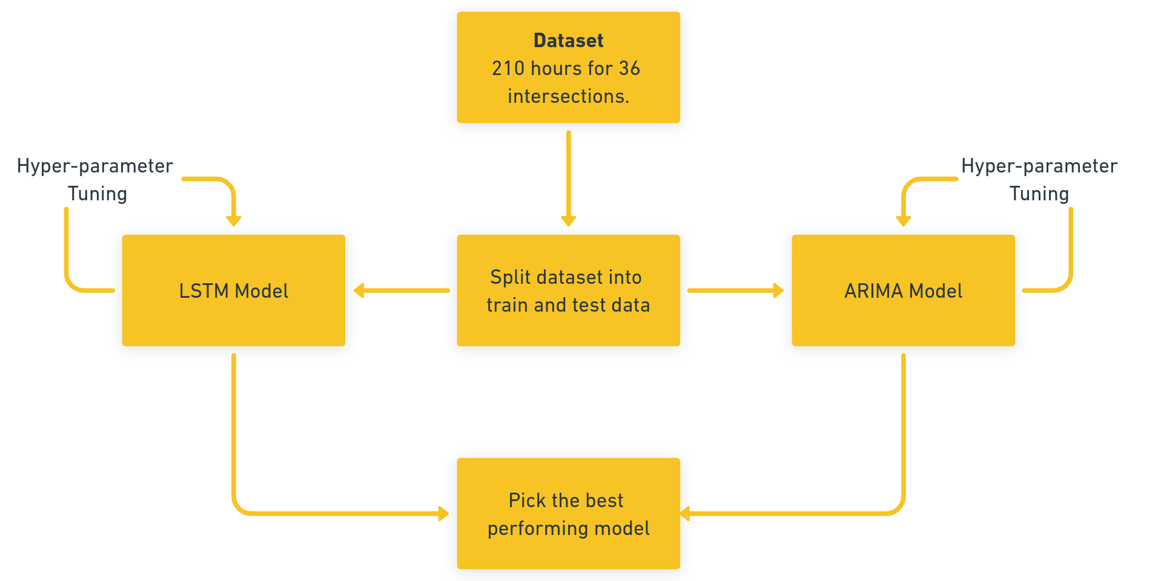
Experimental Procedure - Forecasting
Notes:
To forecast traffic from historical data, we trained the Autoregressive-Integrated- Moving-Average (ARIMA) model with a dataset containing traffic indices for 210 hours for 36 intersections. We also used a Long Short-Term Memory (LSTM) model to capture long-term dependencies. Both models were hyper-parameter-tuned with effectiveness measured. The dataset contained traffic data for 35 days in total, of which the model was trained on 30 days and forecasted on 5 days of data. The effectiveness was measured using the metrics MSE and MAE.

Slide 8
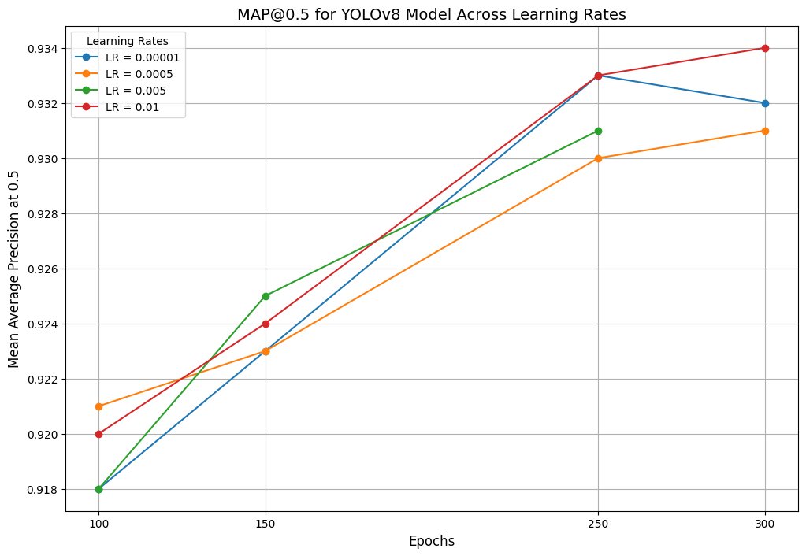
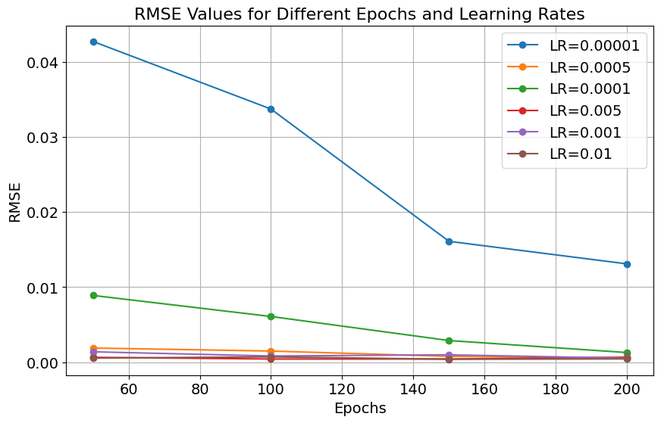
Results
Experiment 1
Experiment 2
Notes:
Experiment 1, with a secondary dataset of aerial images, demonstrated that we could detect vehicles with a high Mean Average Precision (mAP) of 0.934. Follow-up experiments, with footage that we collected at a local intersection in our community using a camera, demonstrated a high mAP of 0.865, showing effectiveness in a local context. In experiment 2 (time series forecasting), the best-performing ARIMA model had Mean Absolute Error (MAE) of 0.0516. The best-performing LSTM model obtained a Mean Squared Error (MSE) of 4.12e-4. The low error rates show that time series forecasting is effective and can be applied to this problem.

Slide 9
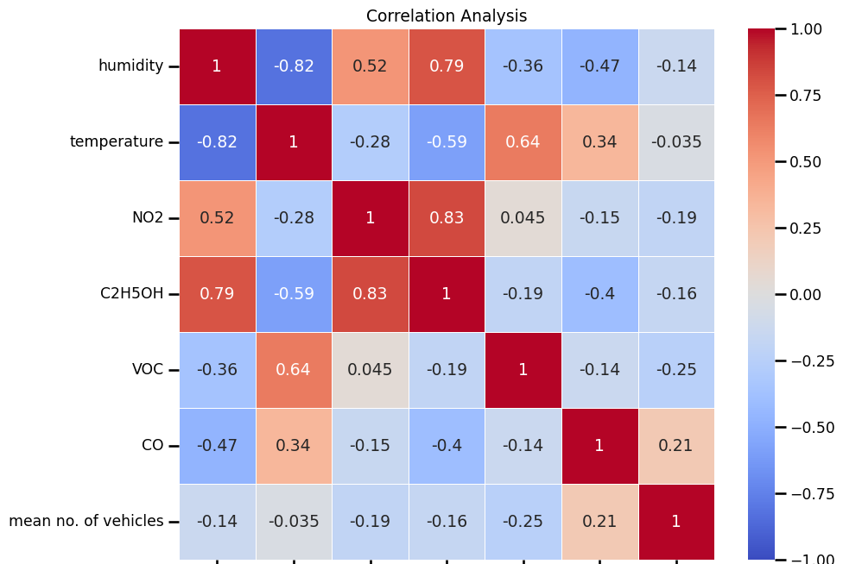
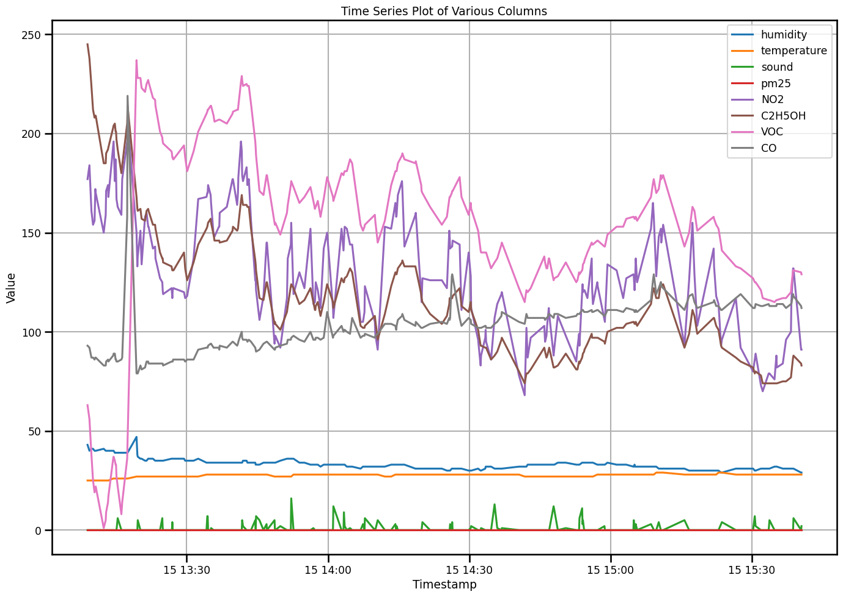
Results
Experiment 1
Experiment 2

Slide 10
Discussion of Results
Notes:
I believe that through this research I have discovered several different elements that can help in traffic planning in the future. The positive results were that traffic could be forecasted using machine learning and that traffic could be detected using low-cost aerial sensors and object detection. I have also demonstrated that low-cost sensors can be used to detect pollution levels effectively.
The surprising negative result was the minimal correlation between traffic and pollution. This surprising result can be put down for a few reasons: perhaps there was a seasonal variation which affected pollution levels. A second possibility is that each additional car does not substantially affect air pollution levels, leading to the notion that there was not enough traffic at my junction.

Slide 11
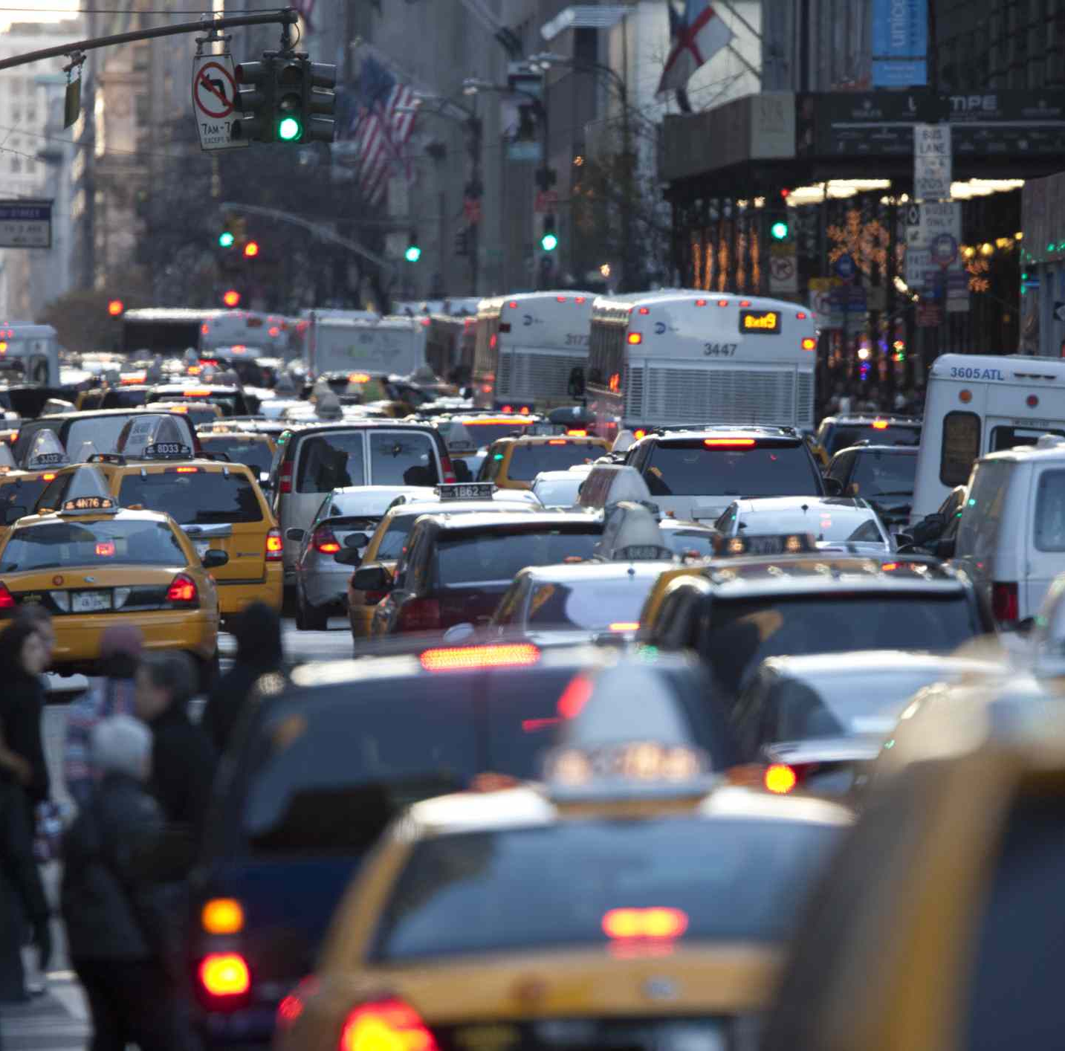
Journey through the Project
Notes:
Whilst collecting air pollution data from our sensor, I encountered some problems. Firstly, the height of the images could have been better as it was placed too low, preventing the object detection model from recognizing vehicles. To address this issue, I altered the zoom of the image, creating the effect of an increased height and improving the model’s detection confidence. The sound readings were too low to be feasible; to mitigate this problem, I tried to increase the sensitivity of the sound sensor, but the readings were still erratic. In the future, I may incorporate a higher-quality sensor to detect noise.

Slide 12
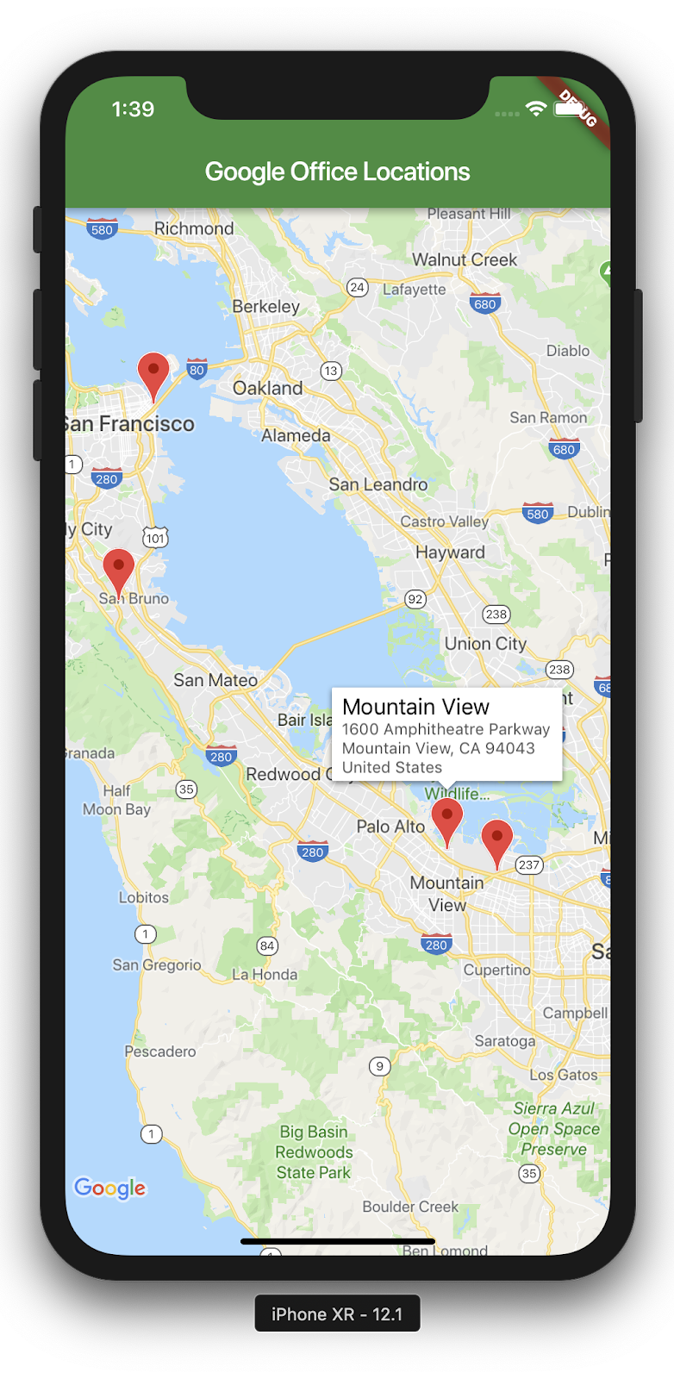

Future Work
Notes:
My vision involves companies like Google and Apple integrating our invention, allowing users to choose not just the fastest but the healthiest route. Integration into GPS like Google Maps minimizes pollution by routing traffic efficiently. Time series models predict greenhouse gas levels, potentially reducing Ultra Low Emission Zone charges. Overall, this approach can help communities to not only measure and predict the traffic flow at their locations but also understand its impact on the environment.

Slide 13

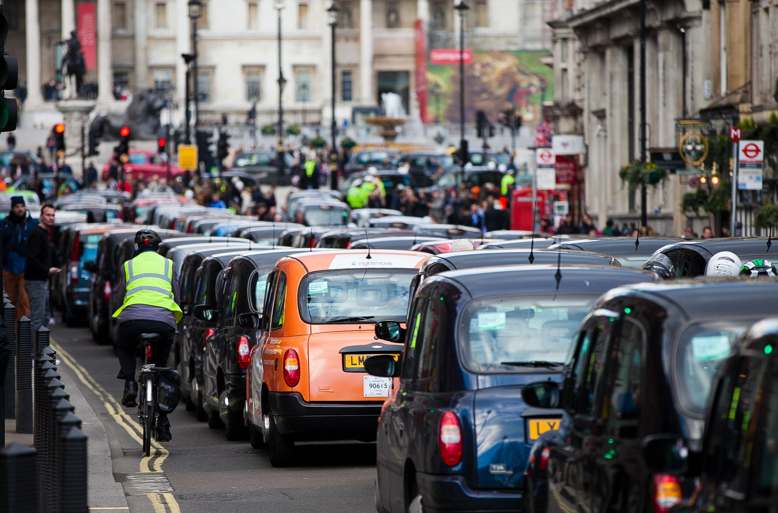
Conclusion
Notes:
In conclusion, my project addresses the urgent issue of traffic congestion and its significant contribution to pollution. Through the development of cost-effective sensors and advanced machine learning models, I aimed to forecast traffic pollution and empower communities with adaptive traffic management solutions.
My research showcased the effectiveness of these models in accurately predicting traffic patterns and detecting vehicles. However, I also encountered challenges, highlighting the need for further investigation. Moving forward, my goal is to refine our solution, enhance sensor accuracy, and expand data collection globally. Ultimately, my approach seeks to empower communities worldwide to understand, predict, and mitigate the impact of traffic on the environment, fostering sustainable urban living for future generations.

